Slide 1
Federation: Open Source SoC Design Methodology
Henry Cook, Principal Engineer
June 22, 2019

Slide 2

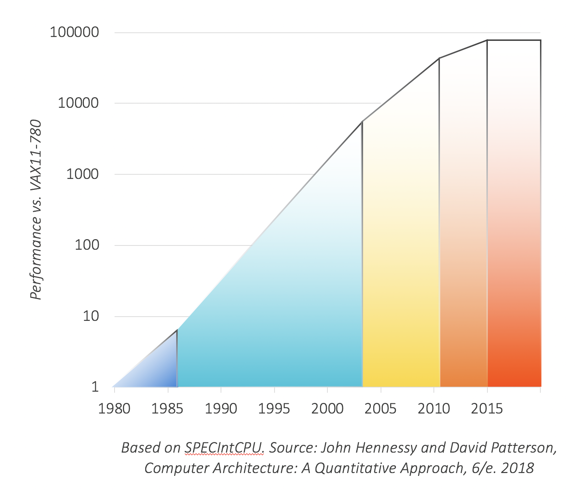
Hardware Trends: Compute Needs are Changing
e.g., machine learning
But, CPUs are not getting faster!
Source: Medium, Entering the world of Machine Learning

Slide 3
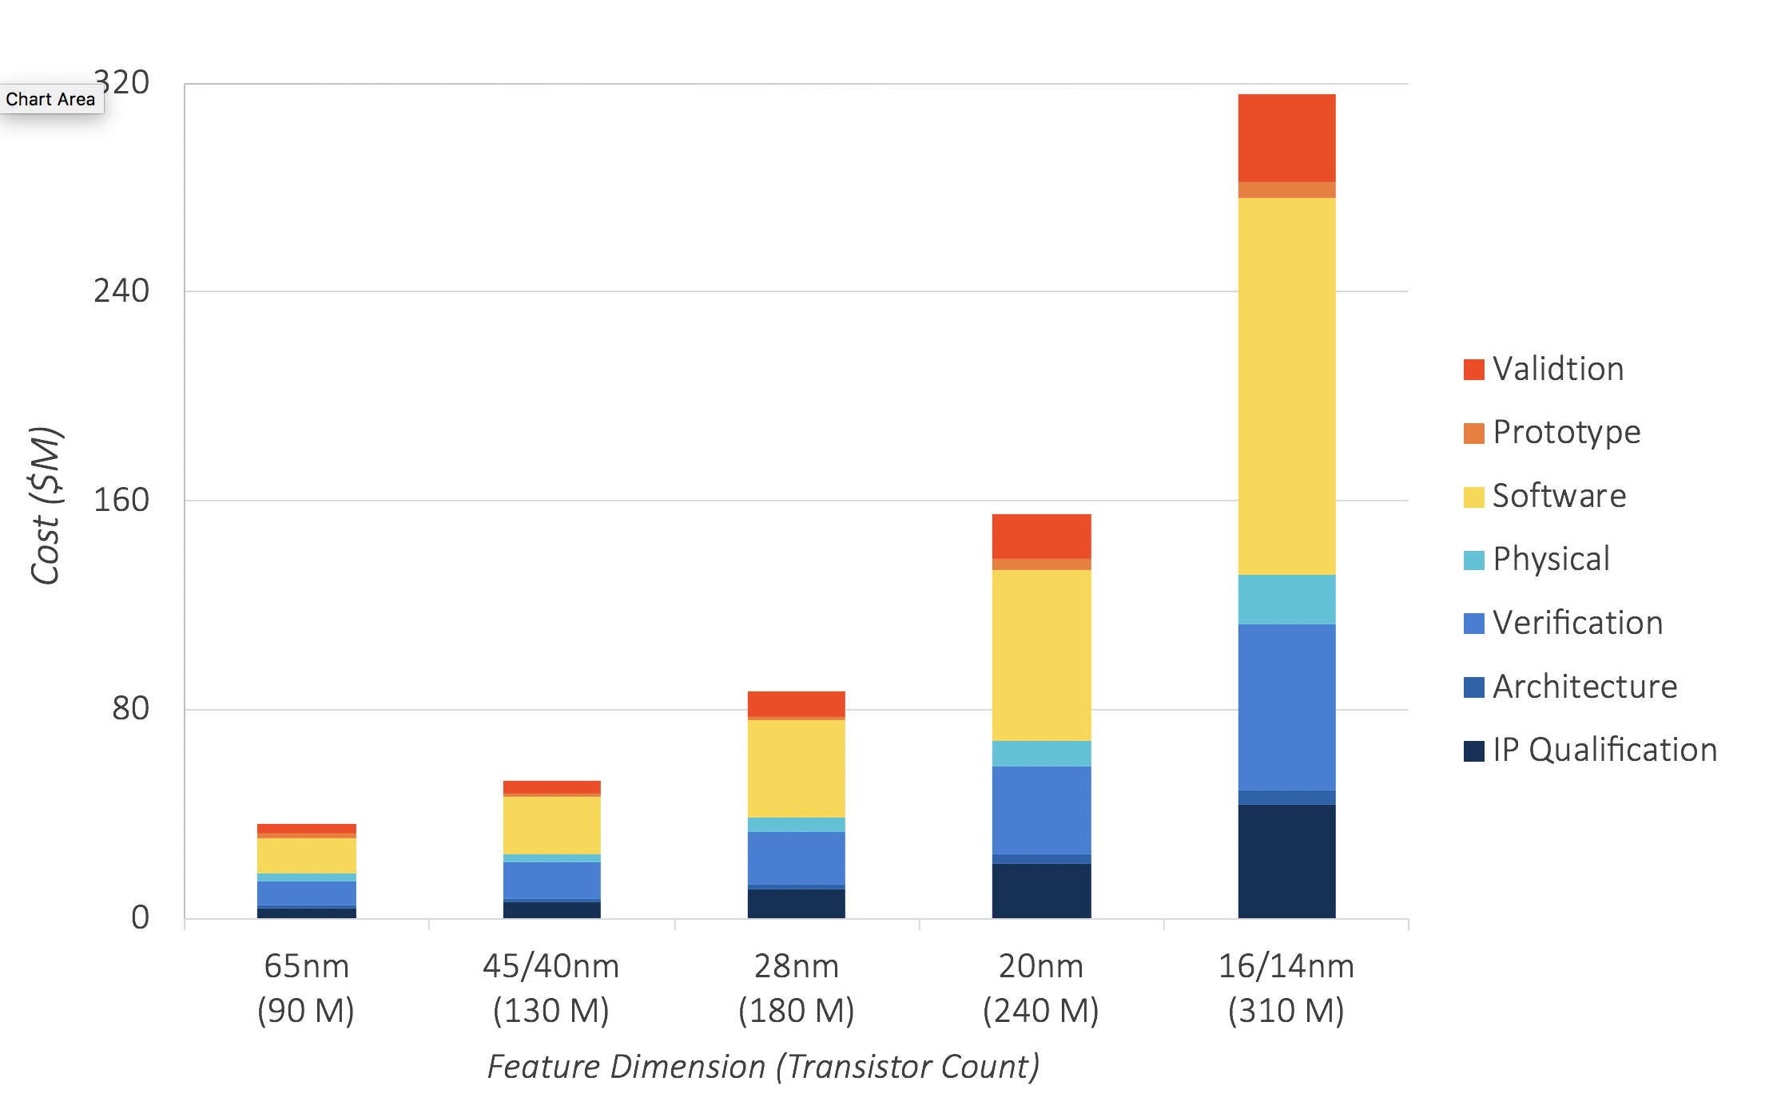

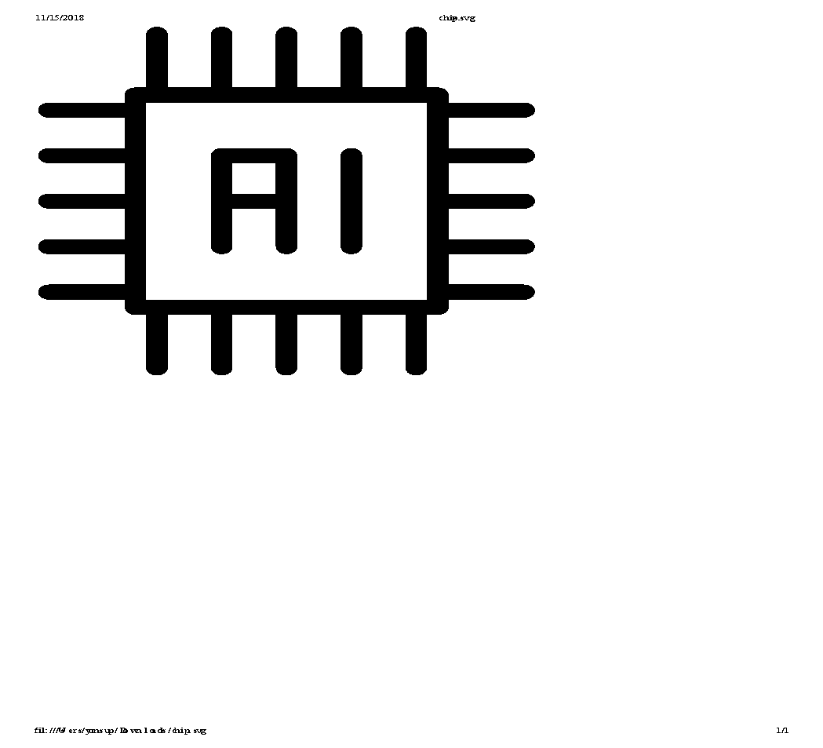
Hardware Trends: Custom Hardware to the Rescue!
GPUs
Custom Chips
(e.g., Google TPU)
But, custom chip development costs are too high!

Slide 4



How did turn into a $1B acquisition with only 13 employees?*
* https://www.sigarch.org/open-source-hardware-stone-soups-and-not-stone-statues-please

Slide 5
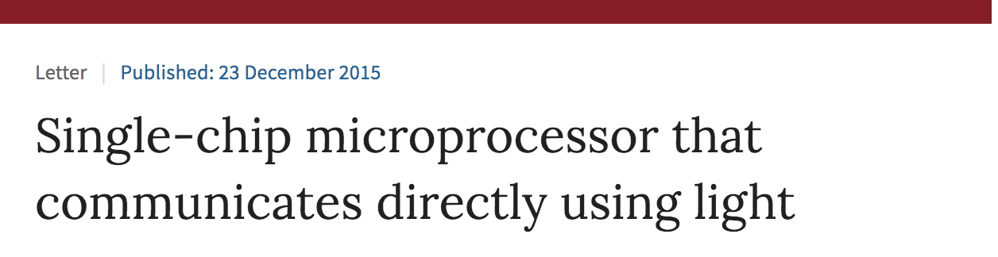
Some research group
Fabricate
How did turn into a $1B acquisition with only 13 employees?*
Coherent Chip MultiProcessor
15
grad students
* https://www.sigarch.org/open-source-hardware-stone-soups-and-not-stone-statues-please

Slide 6
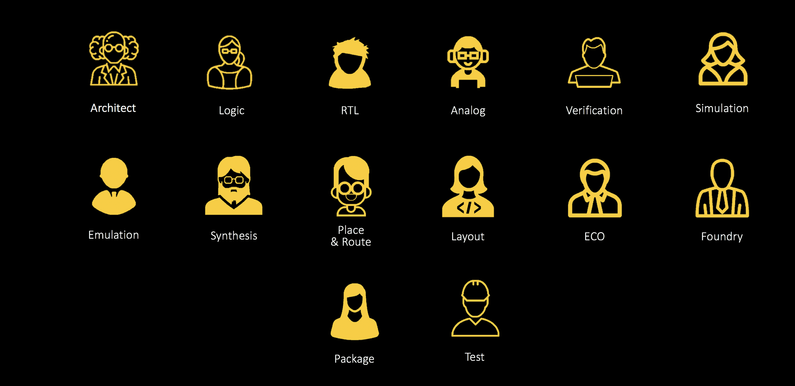
Why do silicon projects need experts
from at least 14+ disciplines just to get started?

Slide 7



















Tech Stack
<Your Name Here>
Tech Stack
Readily-Available
Reusable
Technology
Federation Tools
from techstacks.io
Infrastructure
Cloud Services

Slide 8

We Should Copy “Innovations” from the Software Industry
open-source standards
abstraction and code reuse
composability and APIs
productivity tooling
commodity infrastructure

Slide 9
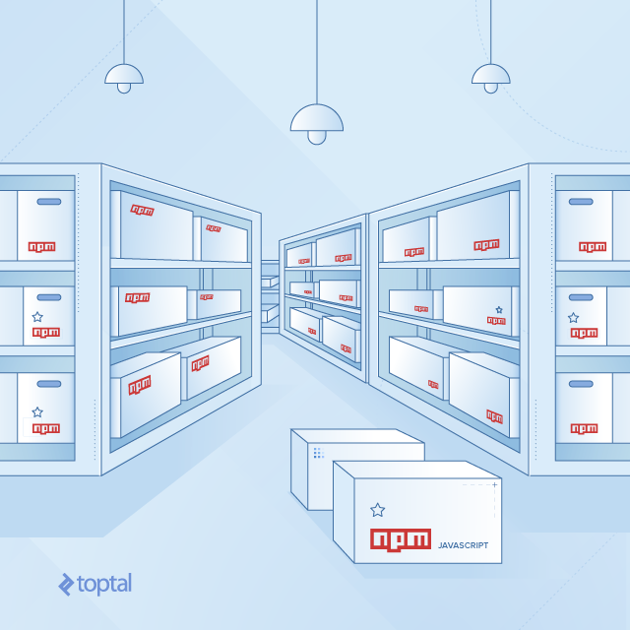
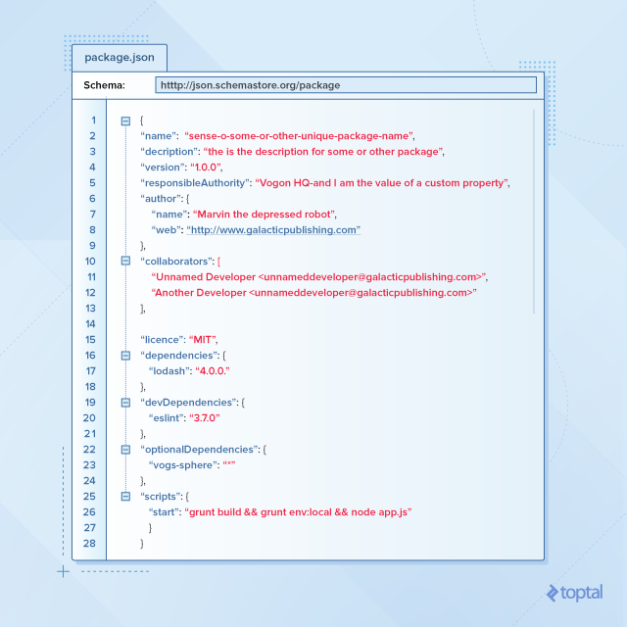
npm Enables Modular Web Development with Reusable Packages
Source: https://go.tiny.cloud/blog/a-guide-to-npm-the-node-js-package-manager/

Slide 10
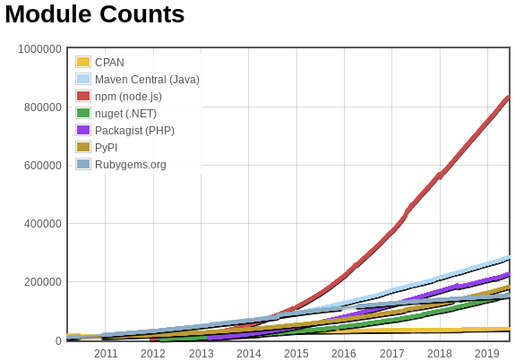
npm Enables Javascript as Most Popular Programming Language
830.000 of packages
10 million users
30 billion packages downloads per month
90% of Web built of NPM packages
NPM used everywhere: client, server, mobile, IoT
Open source libraries availability is the major driving force for Language adoption [Leo2013] proven by NPM
70+ programming languages can be transpiled into JS, WebAssembly and published on NPM

Slide 11
Federation:
the action of forming states or organizations
into a single group with centralized control,
within which smaller divisions have
some degree of internal autonomy
Notes:
Building chips is hard

Slide 12
Federation:
a suite of open-source tools that SiFive is using to orchestrate
modular SoC design workflows
Notes:
Building chips is hard

Slide 13


Federation Tools Enable a Modular SoC Design Methodology
IP Package 1
IP Package 2
IP Package 3
Federation Tools
wit
D∪H
wake
description
description
description
dependencies
dependencies
dependencies
Tool Package 1
commands
Workspace
dependencies
Tool Package 2
commands
dependencies
Checkout workspace by analyzing dependencies of all packages
Read descriptions of all IP packages, and generate assets that are needed for your chip design framework
Collect commands from all tool packages, and generate a flow that is needed to build your SoC
Design your SoC!
Tool Package 3
commands
dependencies

Slide 14
Federation Tools: wit, the Workspace Integration Tool
https://github.com/sifive/wit
wit is a tool for managing dependencies between git repos
(Think of it like git submodules++)
Supplement to (not a replacement for) git-based workflows
Provides a flexible, yet reproducible and deterministic, dependency-resolution algorithm
generates a flattened directory structure in which each package may exist only once
Enables multiple developers to simulatenously develop and deploy features that touch multiple repositories

Slide 15
Benefits of Small, Modular, and Reusable Packages
IP
Package
IP
Package
IP
Package
IP
Package
Tool
Package
Tool
Package
Tool
Package
Tool
Package
Workspace
Workspace
Workspace
Enforces an interface between components; makes it easier to reuse parts in different contexts and designs
Encourages engineers to write unit tests for packages; makes it easier to filter bugs early
Localizes regression test failures; makes it easier to root-cause them
Enables fine-grained access control; makes it easier to open-source or give differential access to components

Slide 16

Federation Tools: D∪H, or Design ∪ Hardware
https://github.com/sifive/duh pronounced [dûx]
A manifest document format capturing integration intent
Components, Designs, Configurations
Ports, Bus Interfaces, Parameter Constraints, Registers,...
Open-Source, JSON5, Extensible, and Generator-Agnostic
Packaging tools for reusable hardware components and designs
Import: Verilog, SystemRDL, IP-XACT,...
Authoring: Document creation, validation
Export: Scala, Chisel, Verilog, IP-XACT, TLM, Documentation
GUI: Query, Search, Configuration, Integration, Analysis

Slide 17
Benefits of a Data Format that Describes IP Generators
IP
Package
Rocket-Chip/CRAFT Framework
(Chisel, FIRRTL, Diplomacy, TileLink)
Chisel BlackBox Wrappers
TileLink Adapters
Diplomacy Nodes
DTS Entries
Documentation Snippets
Your Own Chip Design Framework
Asset #1
Asset #2
Asset #3
…
Decouples the details of the chip design framework from the underlying IP generator; as a result:
Acts as a single source of truth, enforcing the DRY principle
Automatically generates assets that are needed for your chip design framework
Lowers the barrier to adopt your chip design framework
Makes it easier to use the IP package in other chip design frameworks

Slide 18
Federation Tools: wake, orchestrating your build flow
https://github.com/sifive/wake
Wake is a tool and a language to make build systems composable
Defines APIs to distinguish tooling choices from design flow steps
Plugs packages’ build steps together with zero source changes

Slide 19
Federation Tools: wake, orchestrating your build flow
Dependent job execution:
Which jobs to run next can depend on the results of previous jobs. All jobs may be dependent.
Dependency analysis:
Fails builds that will not be reproducible due to underspecified inputs dependencies.
Prunes unused input dependencies so the job will not be re-run unless it must.
You almost never need to tell wake what files a job builds; it knows.
Build introspection:
Wake keeps a database to record what it did.
Query that database at any time to find out exactly how a file in your workspace got there.
Intrinsically-parallel language
While your build orchestration files describe a sequence of compilation steps, the wake language automatically extracts parallelism.
Only true data dependencies cause wake to sequence jobs.
Shared build caching
If wake can prove it's safe, it will just copy the prebuilt files and save you time.
PRs whose regression tests pass immediately, increasing productivity.
Notes:
dependent job execution
Which jobs to run next can depend on the results of previous jobs. For example, when you run configure in a traditional automake system, this typically affects what will be built by make. Similarly cmake. These two-stage build systems are necessary because make job selection cannot depend on the result of a prior build step. In complicated builds, two-stages are sometimes not enough. In wake, all jobs may be dependent.
dependency analysis
In classic build systems, you must specify all the inputs and outputs of a job you want to run. If you under-specify the inputs, the build is not reproducible; it might fail to compile files that need recompilation and the job might fail non-deterministically on systems which run more jobs simultaneously. If you over-specify the inputs, the build performs unnecessary recompilation when those inputs change. In wake, if you under-specify the inputs, the build fails every time. If you over-specify the inputs, wake automatically prunes the unused dependencies so the job will not be re-run unless it must. You almost never need to tell wake what files a job builds; it knows.
build introspection
When you have a built workspace, it is helpful to be able to trace the provenance of build artefacts. Wake keeps a database to record what it did. You can query that database at any time to find out exactly how a file in your workspace got there.
intrinsically-parallel language
While your build orchestration files describe a sequence of compilation steps, the wake language automatically extracts parallelism. Everything runs at once. Only true data dependencies cause wake to sequence jobs. Wake handles parallelism for you, so you don't need to think about it.
shared build caching
You just checked-out the master branch and started a build. However, your system runs the same software as your colleague who authored that commit. If wake can prove it's safe, it will just copy the prebuilt files and save you time. This can also translate into pull requests whose regression tests pass immediately, increasing productivity.

Slide 20
Case Study 1: Programmed-IO IP Package
block-pio-sifive
AXI MMIO
IRQ
PIO IP Block
oenable
odata
idata
IP containing IO-programmable register map
D∪H generation of wrapper containing Scala classes, Chisel blackbox, Diplomacy Nodes, Rocket-Chip traits

Slide 21
Case Study 1: Programmed-IO IP Package Integration
soc-testsocket-sifive
RISC-V
Test
Socket
Rocket Processor
rocket-chip
block-pio-sifive
AXI MMIO
IRQ
PIO IP Block
oenable
odata
idata
Loopback VIP Block
idata = oenable ^ odata
https://github.com/sifive/block-pio-sifive

Slide 22
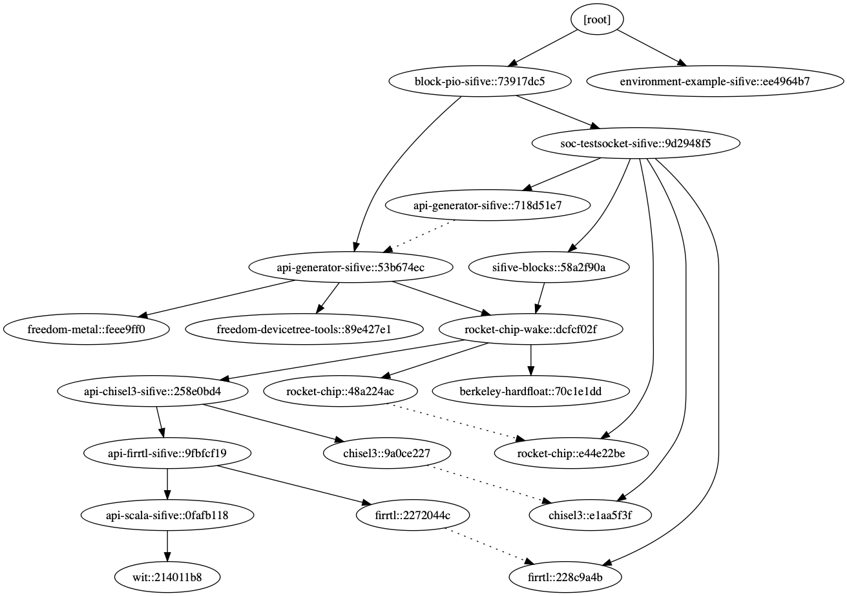
block-pio-sifive Package Dependency Graph

Slide 23
Case Study 2: Cache Coherent SoC Template
block-inclusivecache-sifive
TL-C
InclusiveCache
TL-UH
Coherent, last-level inclusive cache
Full directory bits stored with metadata tag
TileLink adapter; drop-in replacement for tilelink.BroadcastHub
SW-controlled flush interface
Easily Config-ure size, ways, banking and sub-banking factors, external bandwidth, buffering

Slide 24
Case Study 2: Cache Coherent System Template Integration
Rocket Tile
soc-freedom-sifive
Freedom SoC
FPGA Template
Rocket Tile
Rocket Tile
Rocket Tile
rocket-chip
TL SystemBus
TL-C
block-inclusivecache-sifive
InclusiveCache
TL-UH
TL MemoryBus
FPGA DDR Controller(s)
fpga-shells
https://github.com/sifive/block-inclusivecache-sifive

Slide 25
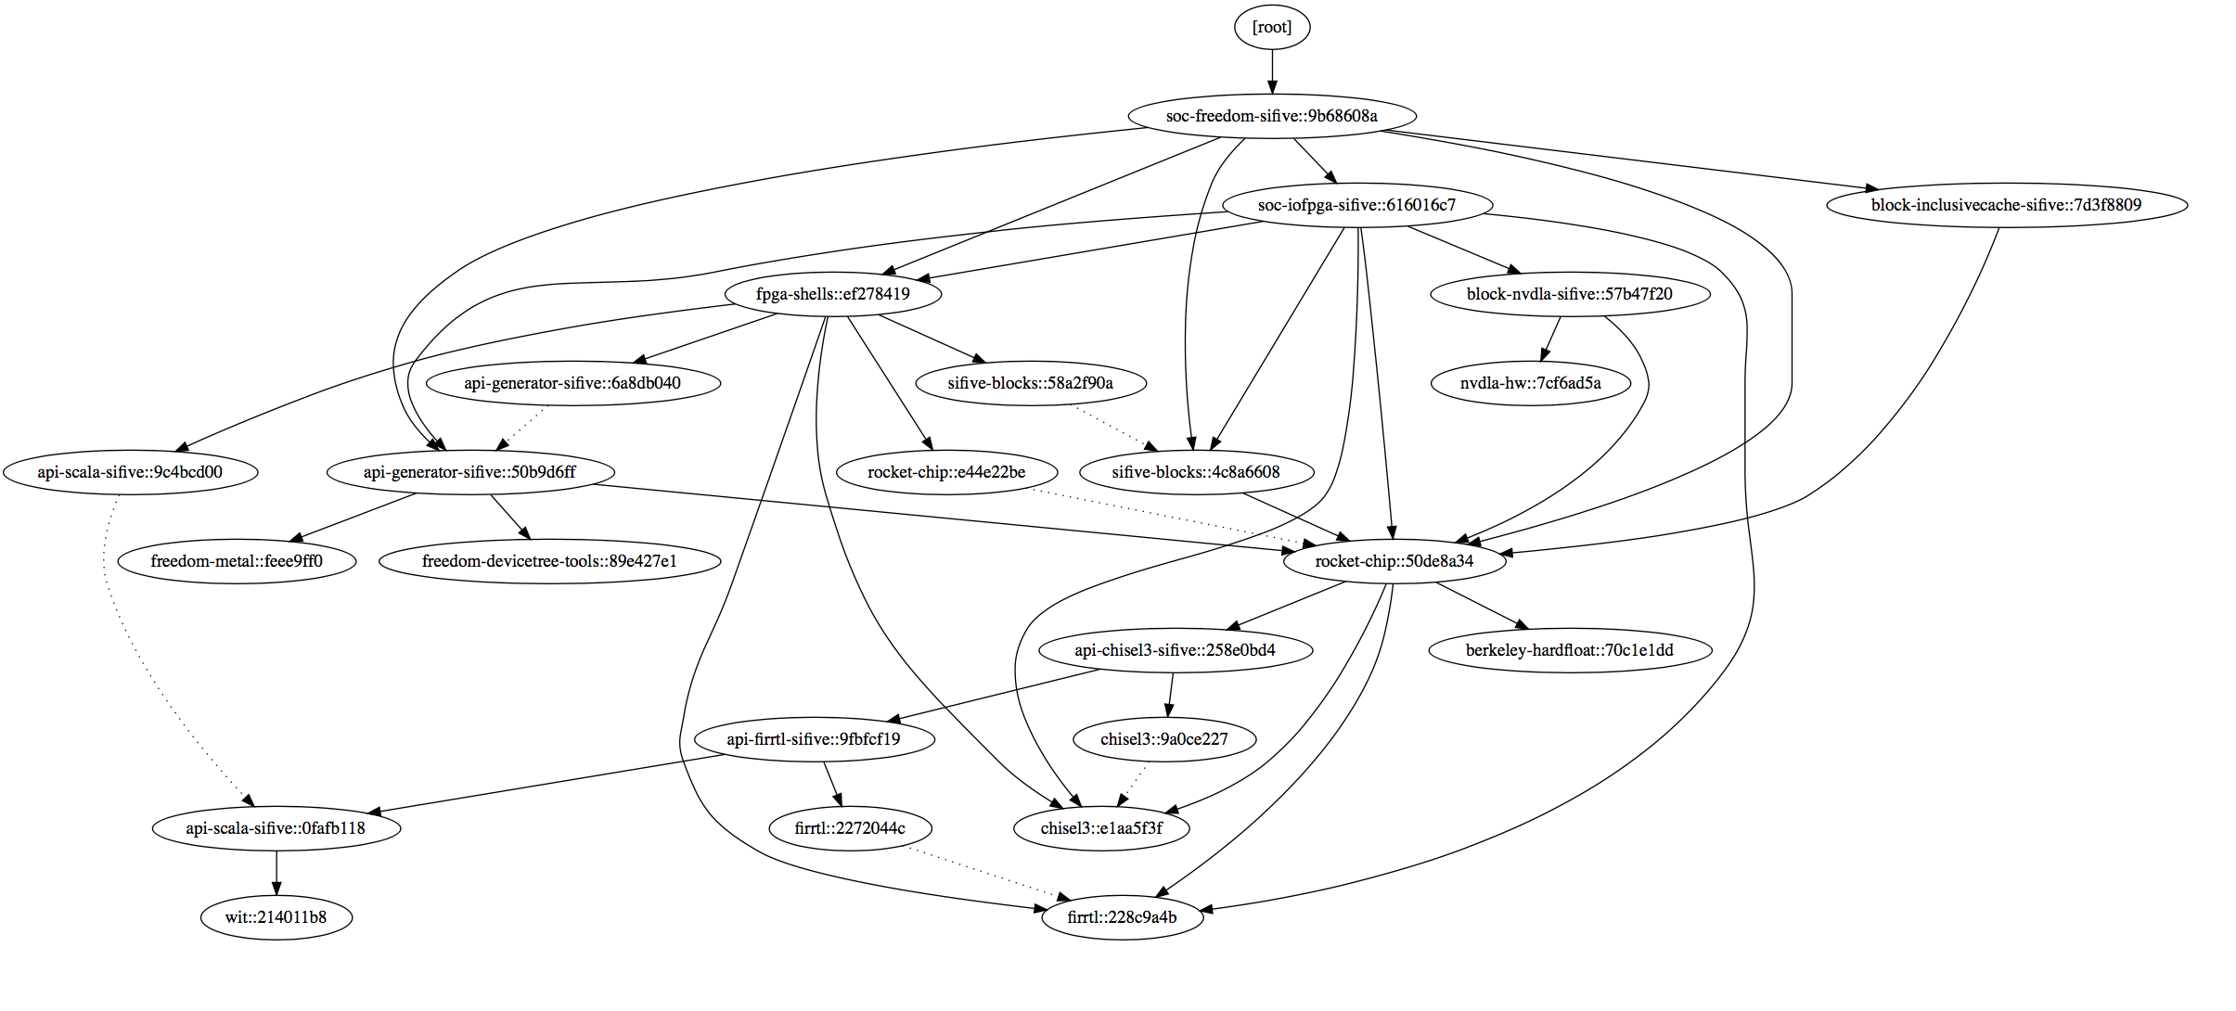
soc-freedom-sifive Package Dependency Graph

Slide 26

Open Source Package Progress (SiFive packages)
Example projects
https://github.com/sifive/block-pio-sifive
https://github.com/sifive/soc-testsocket-sifive
https://github.com/sifive/soc-iofpga-sifive
https://github.com/sifive/soc-freedom-sifive
CRAFT framework APIs
https://github.com/sifive/api-generator-sifive
https://github.com/sifive/api-scala-sifive
https://github.com/sifive/api-chisel3-sifive
https://github.com/sifive/api-firrtl-sifive
https://github.com/sifive/environment-example-sifive
Packaged blocks
https://github.com/sifive/block-inclusivecache-sifive
https://github.com/sifive/block-pio-sifive
https://github.com/sifive/block-nvdla-sifive
Federation tools
https://github.com/sifive/wit
https://github.com/sifive/duh
https://github.com/sifive/wake

Slide 27


Open Source Roadmap (Other Related Projects)
Rest of SiFive’s Freedom repository will be refactored into packages in Q3 of 2019
https://github.com/sifive/freedom => https://github.com/sifive/soc-freedom-sifive
Rocket-Chip repository has been moved to the CHIPS Alliance github org
will be refactored into packages in 2H of 2019
https://github.com/freechipsproject/rocket-chip => https://github.com/chipsalliance/rocket-chip
CHIPS Alliance: a subsidiary of the Linux Foundation https://github.com/chipsalliance/ https://chipsalliance.org/
Rocket-Chip
Chisel / FIRRTL
TileLink + OmniXtend
Verilator
SweRVE
FuseSoC
CocoTB

Slide 28
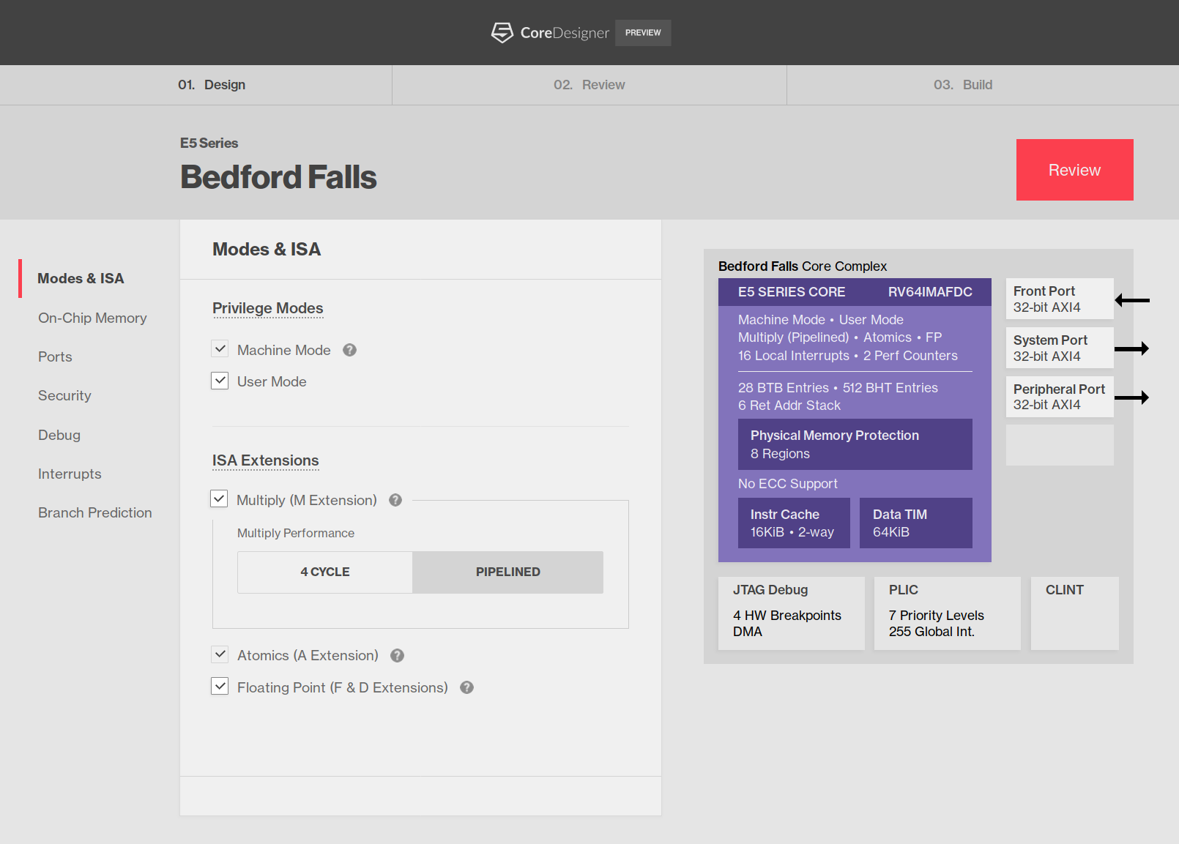
SiFive Core Designer
RISC-V Core IP Customization and Push-Button Configuration
https://www.sifive.com/core-designer

Slide 29
Thanks!

Slide 30
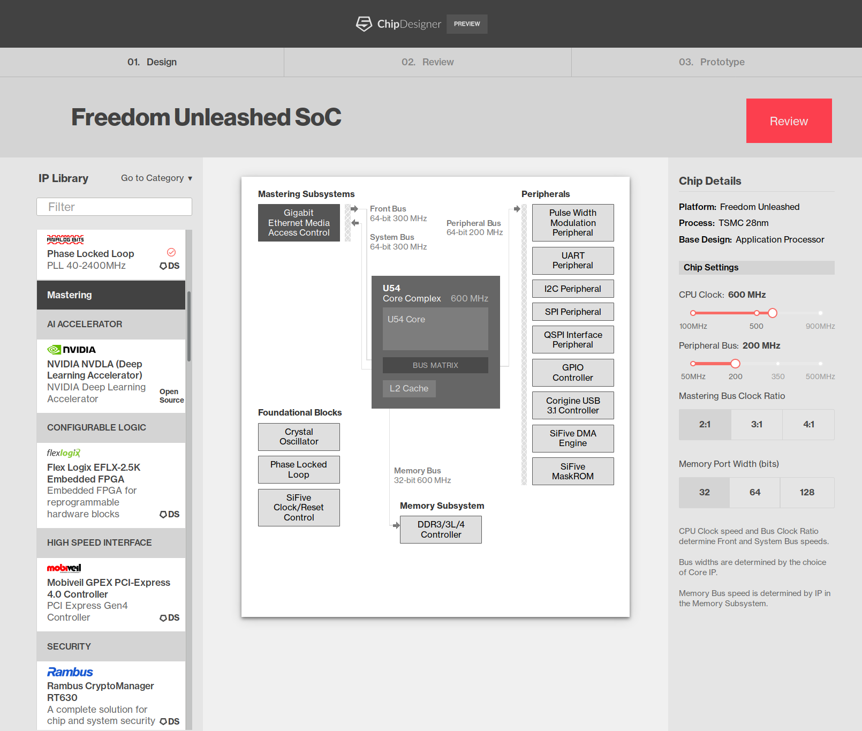














SiFive Chip Designer
Coming soon
Design
Infrastructure
EDA
IP
Fab
Package/Test

